Slide 1

Compact SiC based Automotive Inverter for future 4-wheeler BEVs
Presenter
Rajat Sankhla
MTP Guide
Prof. Shiladri Chakraborty

Slide 2
Outline
Motivation for compact traction inverter
What makes Inverter of an EV powertrain bulky ?
Influence of 800 V architecture on DC link Capacitor size and inverter efficiency
How to do capacitor sizing in 2 Level Inverter ?
Algorithm for capacitor selection
Identification of optimal switching frequency zone
Why more capacitor current reduction is desired ?
Utilization of SiC for reduction in losses and size of heat sink
High dv/dt problems due to 800 V bus and SiC
How common mode voltage is detrimental to motor health
Topological overview of Traction Inverters for passenger BEVs
Comparison of Inverter Candidates operating with SVM at Base speed Ma = 1.15
Carrier Interleaved and fundamental phase shift modulated Multi-phased 2 Level Inverters
Results of interleaving and fundamental phase shift on capacitor rms current
Trade-off between minimum capacitor current and min common mode operating angles

Slide 3
Outline
Motivation for compact traction inverter
What makes Inverter of an EV powertrain bulky ?
Influence of 800 V architecture on DC link Capacitor size and inverter efficiency
How to do capacitor sizing in 2 Level Inverter ?
Algorithm for capacitor selection
Identification of optimal switching frequency zone
Why more capacitor current reduction is desired ?
Utilization of SiC for reduction in losses and size of heat sink
High dv/dt problems due to 800 V bus and SiC
How common mode voltage is detrimental to motor health
Topological overview of Traction Inverters for passenger BEVs
Comparison of Inverter Candidates operating with SVM at Base speed Ma = 1.15
Carrier Interleaved and fundamental phase shift modulated Multi-phased 2 Level Inverters
Results of interleaving and fundamental phase shift on capacitor rms current
Trade-off between minimum capacitor current and min common mode operating angles

Slide 4
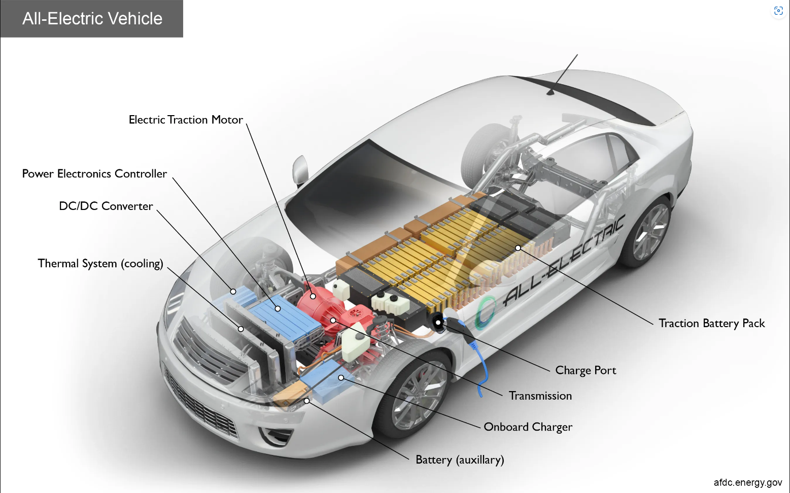
Motivation for Compact Traction Inverter
Range anxiety
More efficient powertrain
High energy density battery
Long Charging time
Using high power OBC utilizing 800 V DC bus
Cost
Setting up huge charging infrastructure is required good policies.
What Power electronics engineer can do ?
https://afdc.energy.gov/vehicles/how-do-all-electric-cars-work
Notes:
For the mass adoption of Evs, there are three main challenges…

Slide 5
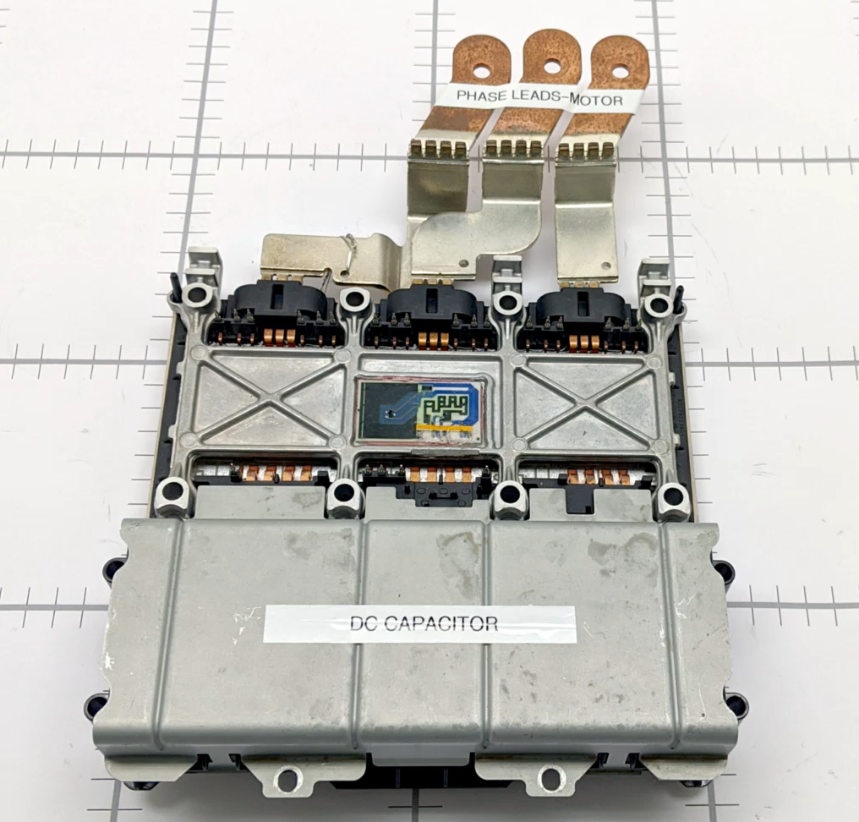

Slide 6

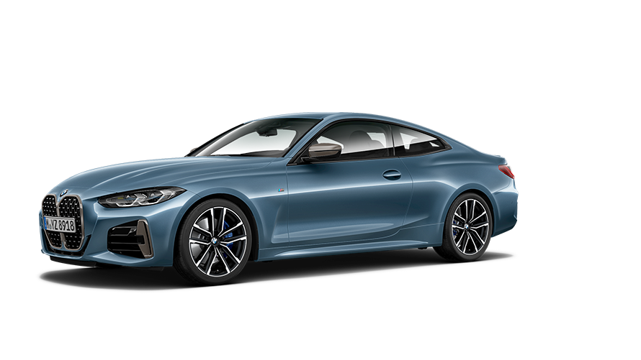
Motivation for Compact Traction Inverter
Tesla Model 3
BMW 418d
Dimensions (L X W X H) in³ 184.8 X 72.8 X 56.8
Dimensions (L X W X H) in³ 188.6 X 74.29 X 54.84
Kerb Weight 1844 kg
Kerb Weight 1510 kg
Range 536 km
Range 1260 Km
www.carwale.com/tesla-cars/model-3/
Notes:
For mass adoption this range has to be extended.

Slide 7
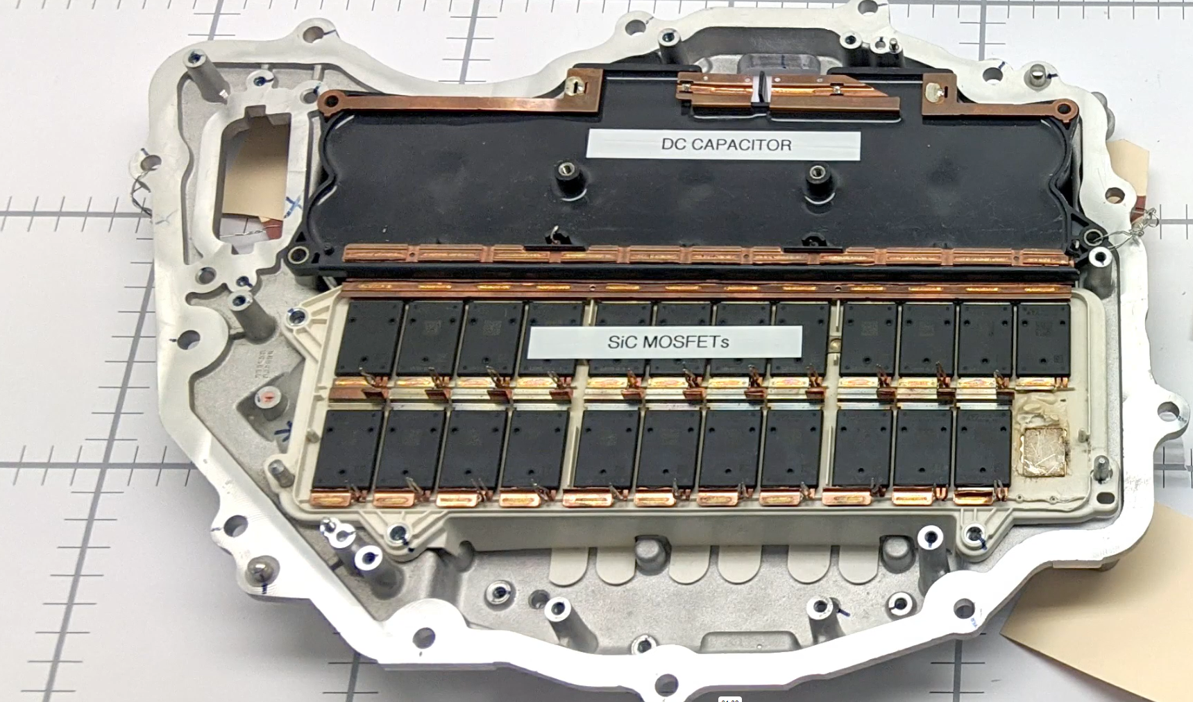
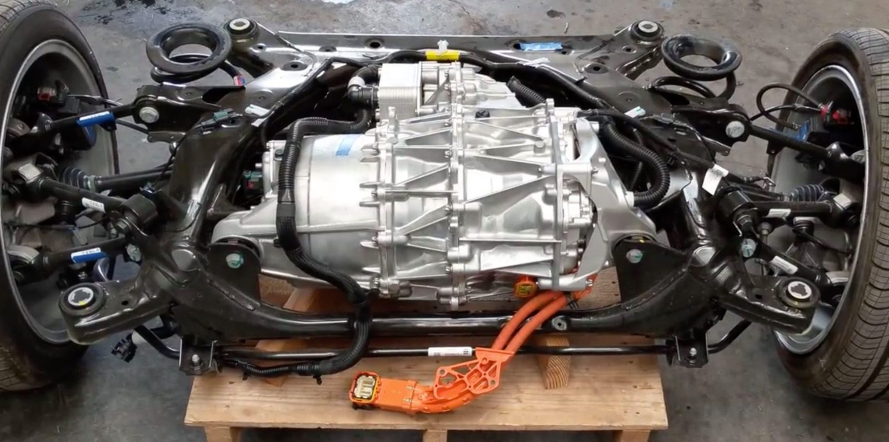
What makes an Inverter of an EV Powertrain bulky ?
Tesla Model 3
Jaguar I-Pace
Tesla Model 3
Tesla Model 3 teardown gives incredible look at the electric powertrain | Electrek
Charged EVs | Teardown expert Sandy Munro compares Tesla, Nissan, Jaguar inverters - Charged EVs
Notes:
Bulky components after battery pack.

Slide 8
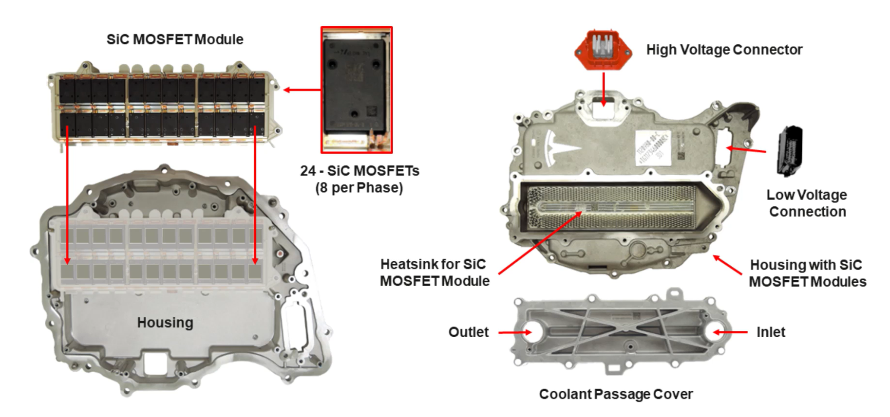
Charged EVs | Teardown expert Sandy Munro compares Tesla, Nissan, Jaguar inverters - Charged EVs

Slide 9
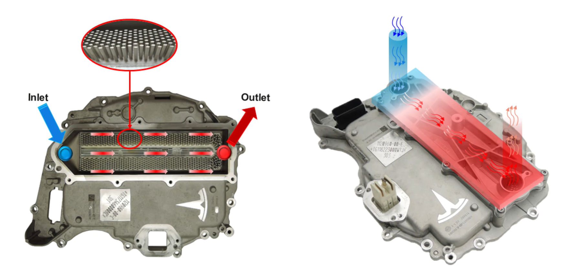
Charged EVs | Teardown expert Sandy Munro compares Tesla, Nissan, Jaguar inverters - Charged EVs

Slide 10
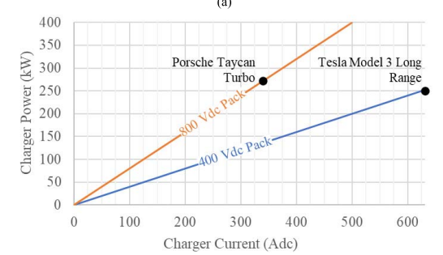
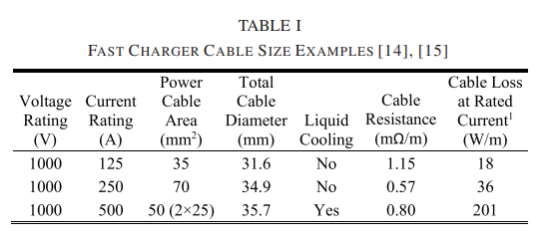
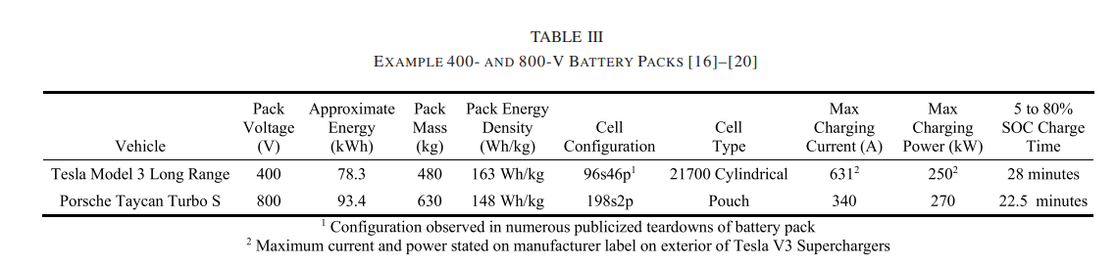

Slide 11
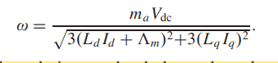
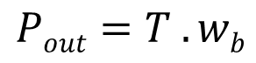
Reduction in size of motor with increase in DC link voltage
For same power output , torque requirement reduces.
Torque capability is proportional to machine size, therefore machine size reduces.

Slide 12
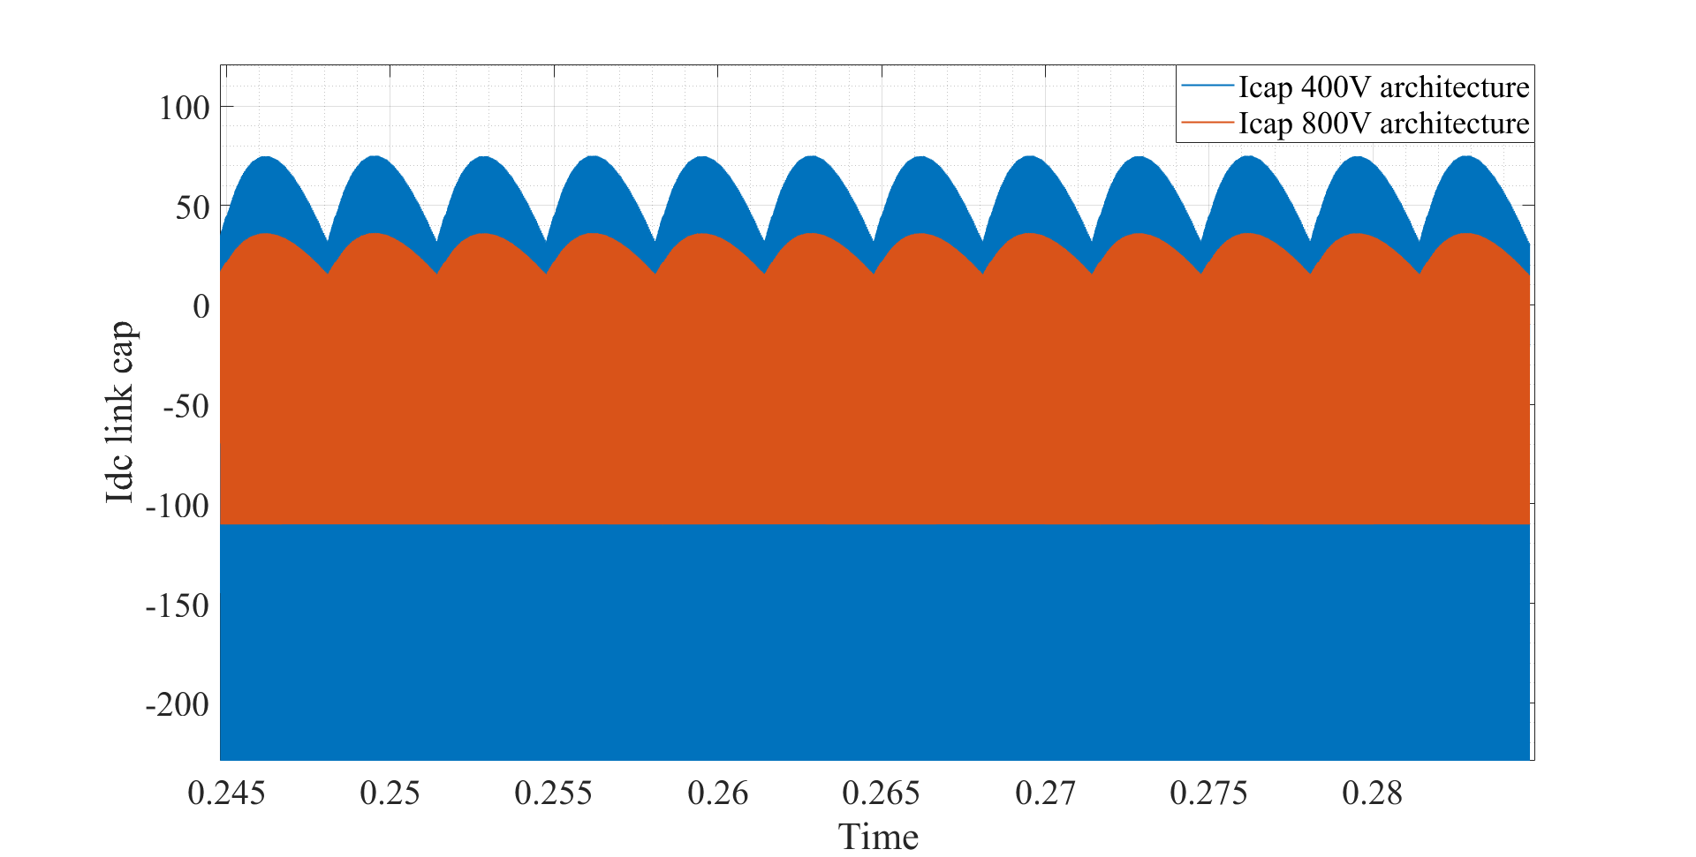
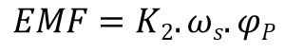
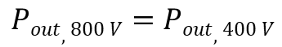
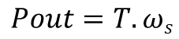
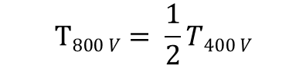
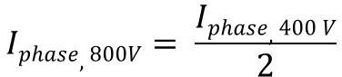
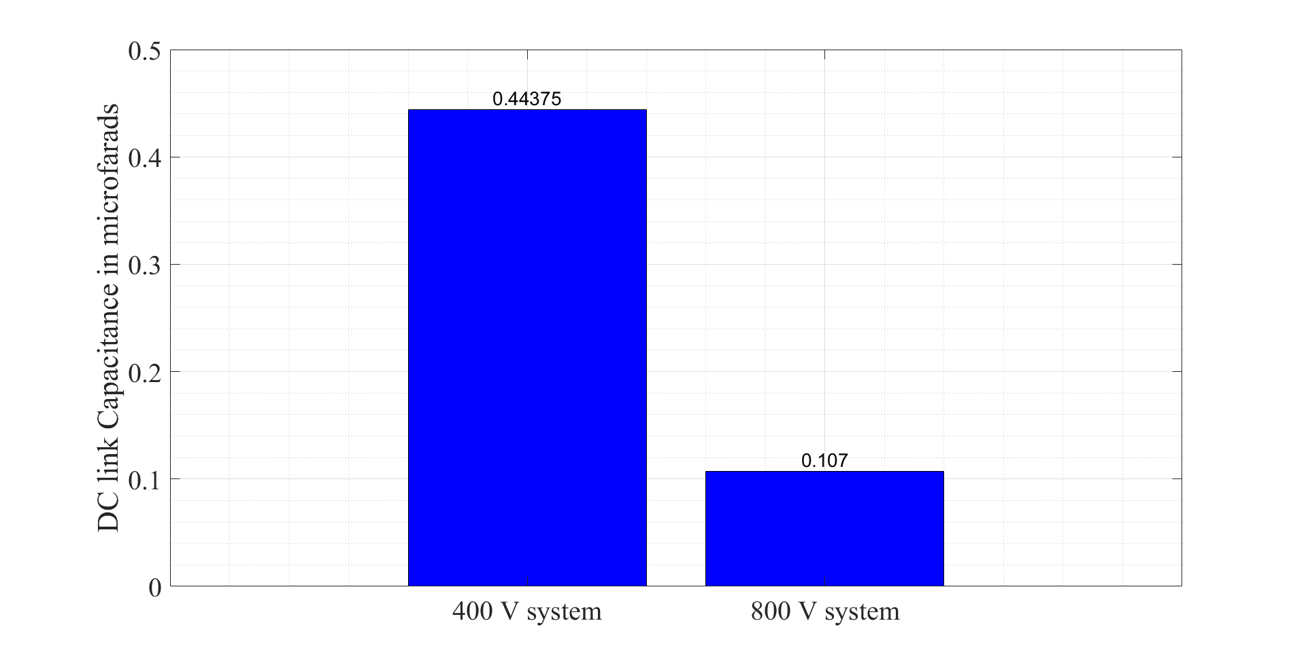
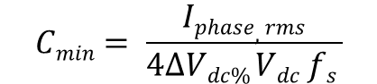
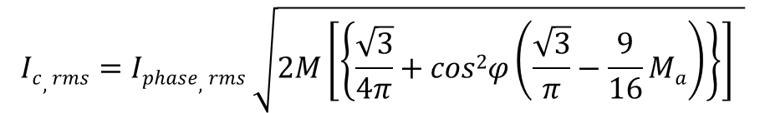
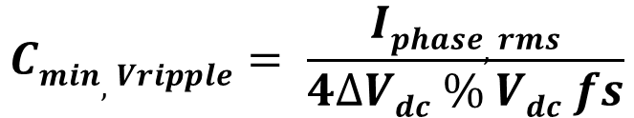
Influence of 800 V architecture on DC link Capacitor size and inverter efficiency
$$Cmin,Vripple= \frac{Iphase,rms}{4∆Vdc \% Vdc fs}$$
Reimers, L. Dorn-Gomba, C. Mak and A. Emadi, "Automotive Traction Inverters: Current Status and Future Trends,"
Notes:
While the impact of 800 V DC bus is clear on the OBC side. Let's explore its benefits on traction inverter.
Explain the benefit of torque half, speed double.
Reduction in phase current means reduction in motor copper losses.
The same torque can be achieved using gearbox.
Reduction in phase current means reduction in inverter conduction and switching losses.

Slide 13
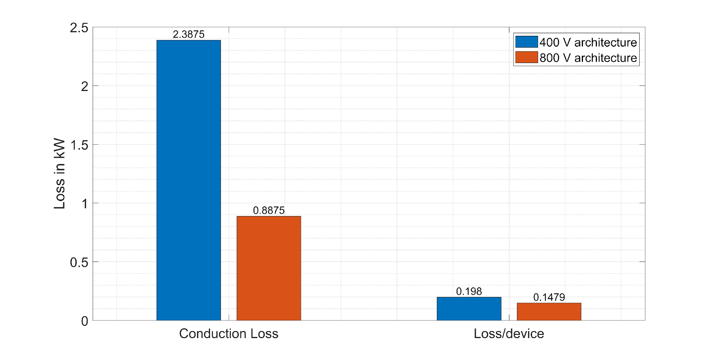
Notes:
Efficiency is improved, size of heat sink will reduce.
Loss/device is reduced means component can be placed close to each other leading to compact design.
Switching loss are not considered.

Slide 14
C3M0045065K | CAB016M12FM3
N = 3, Rdson = 45 mohm Rdson Equivalent = 15mohm | Rds on = 16 mohm 82 A

Slide 15
Outline
Motivation for compact traction inverter
What makes Inverter of an EV powertrain bulky ?
Influence of 800 V architecture on DC link Capacitor size and inverter efficiency
How to do capacitor sizing in 2 Level Inverter ?
Algorithm for capacitor selection
Identification of optimal switching frequency zone
Why more capacitor current reduction is desired ?
Utilization of SiC for reduction in losses and size of heat sink
High dv/dt problems due to 800 V bus and SiC
How common mode voltage is detrimental to motor health
Topological overview of Traction Inverters for passenger BEVs
Comparison of Inverter Candidates operating with SVM at Base speed Ma = 1.15
Carrier Interleaved and fundamental phase shift modulated Multi-phased 2 Level Inverters
Results of interleaving and fundamental phase shift on capacitor rms current
Trade-off between minimum capacitor current and min common mode operating angles

Slide 16
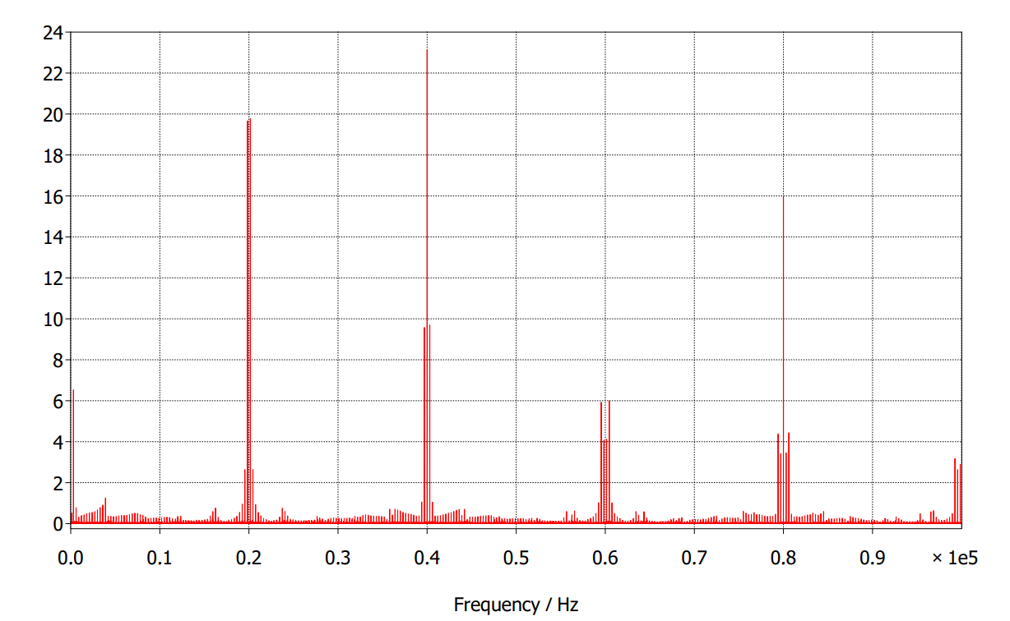
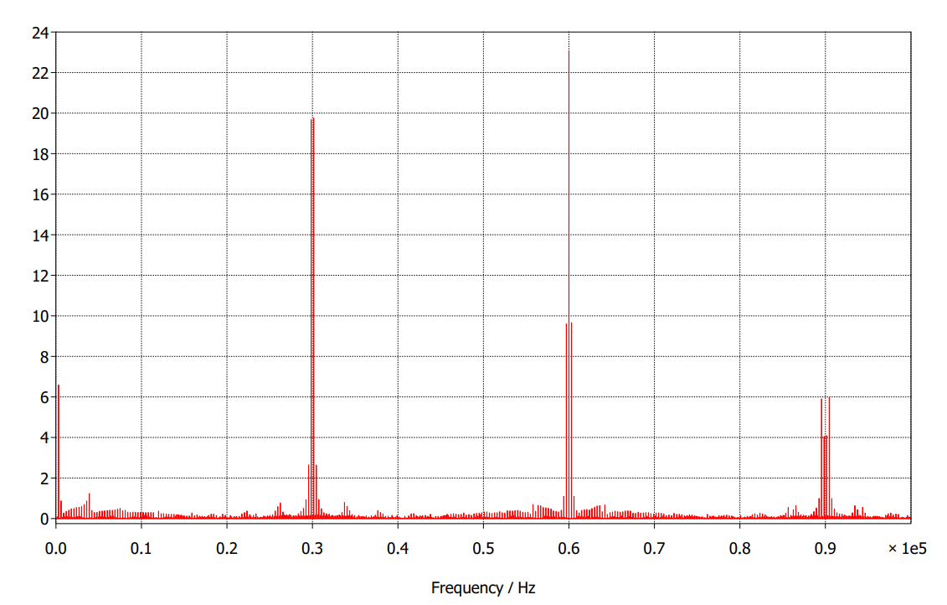
How to do capacitor sizing in 2 Level Inverter ?
FFT of 2 Level Inverter
fs = 20 kHz
fs = 30 kHz
I_{peak,cap}
I_{peak,cap}
Notes:
While it's clear that with 800 V capacitance value required for filtering will reduce and capacitor current will reduce, let's deduce its physical size reduction through capacitor selection process.

Slide 17
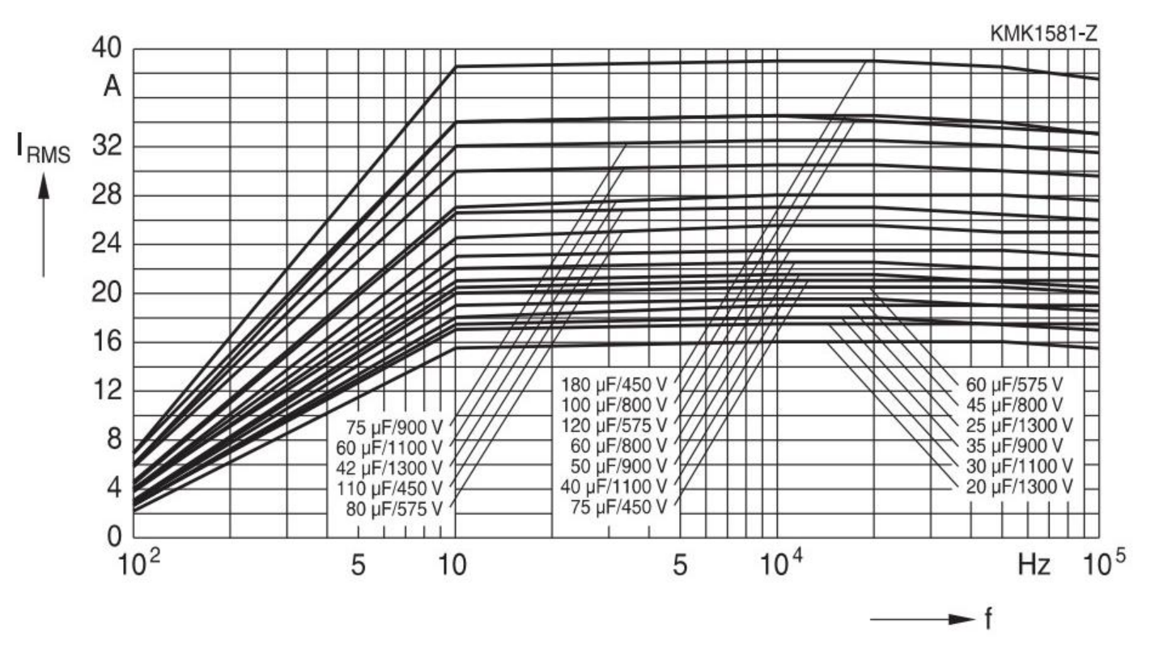
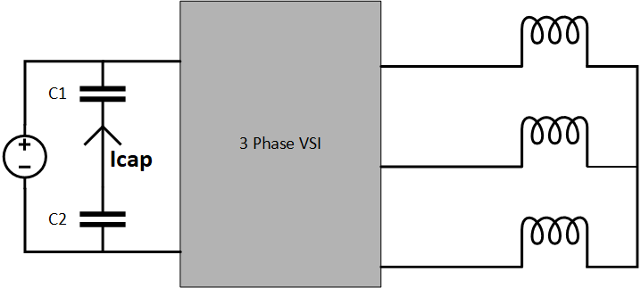
How to do capacitor sizing in 2 Level Inverter ?
I_{rms} permissible curves at ambient of 70° C
"Film capacitors-Metallized polypropylene film capacitors (MKP) by EPCOS-TDK".
Notes:
Let say my inverter is switching at 20 kHz, then for a 2 Level inverter, dominant harmonic is present at 2fs in unipolar modulation scheme. The manufactures gives these Irms permissible curves.

Slide 18
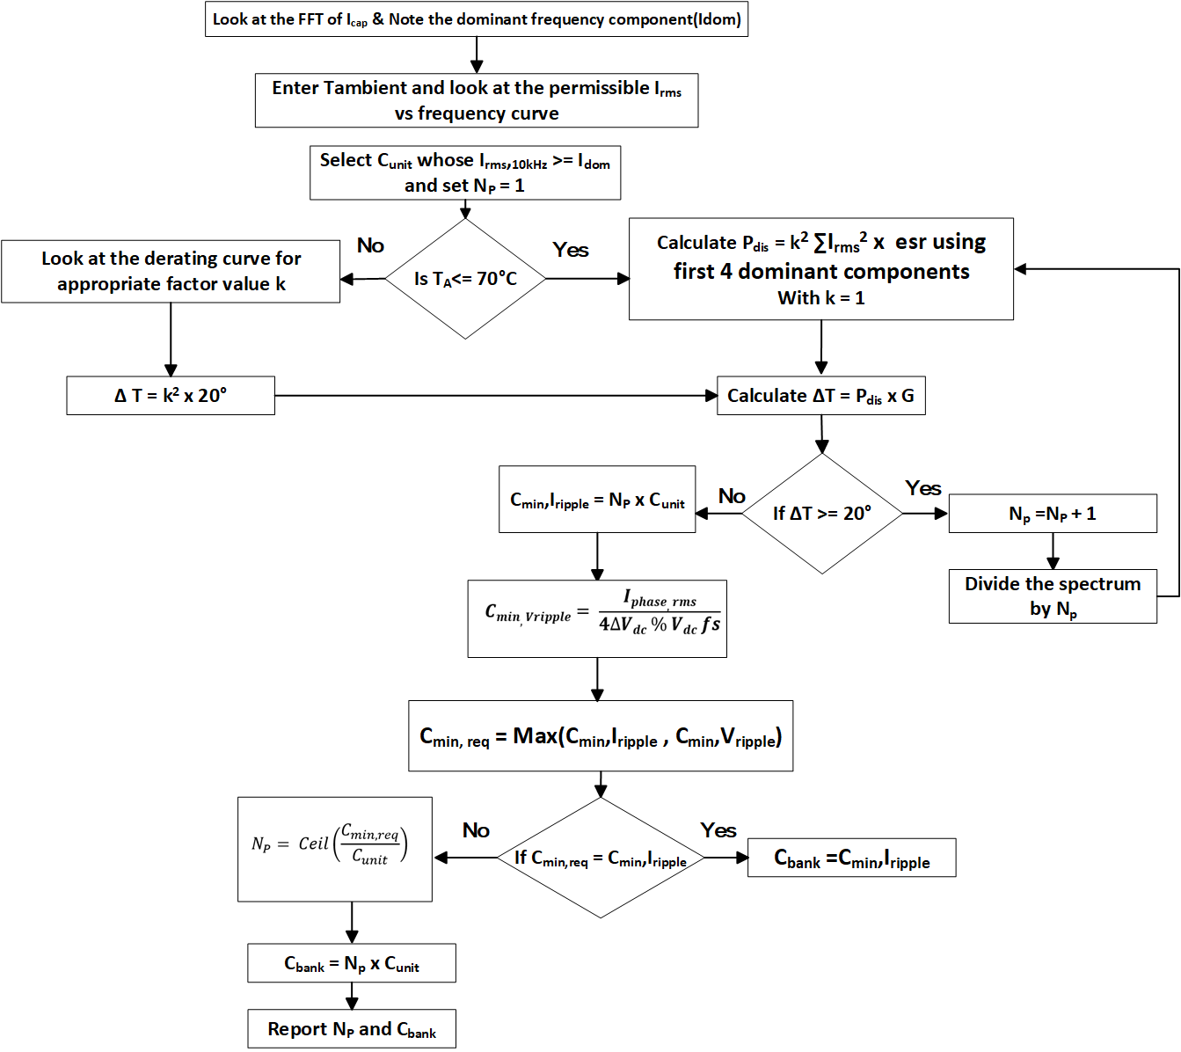
Algorithm for capacitor selection
Notes:
Explain the algorithm.

Slide 19
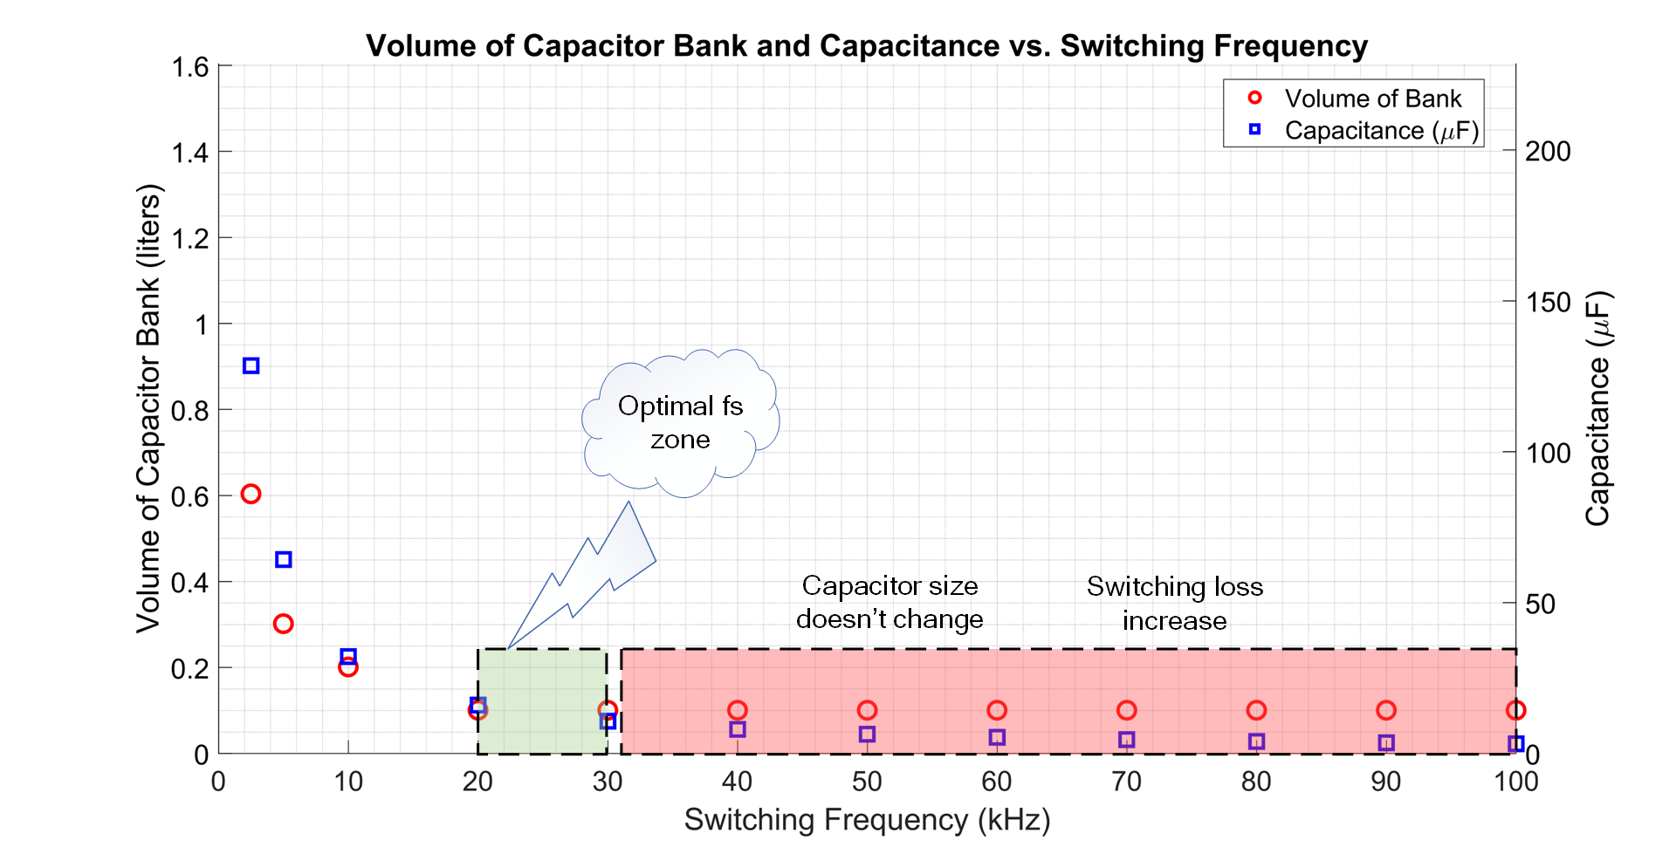
Identification of optimal switching frequency zone
C_{bank} = N_{p} x C_{unit}
"Film capacitors-Metallized polypropylene film capacitors (MKP) by EPCOS-TDK".
Notes:
C is inversely proportional to fs, fs increase, Cmin required for meeting voltage ripple reduces but Cmin for meeting current ripple doesn’t change and Cmin = Max(Cmin,vripple , Cmin,Iripple).
But Ic,rms doesn’t depend on frequency, it depends on phase current, modulation index and PF.
There is no point of increasing fs beyond this range as switching losses will increase.

Slide 20
fs = 20 kHZ
fs = 30 kHZ
I_{peak,cap}
I_{peak,cap}
Conclusions
Cap-design for traction inverter is decided by current ripple.
There exists a upper limit of switching frequency, after which there is no benefit of increasing frequency because switching loss dominates.

Slide 21
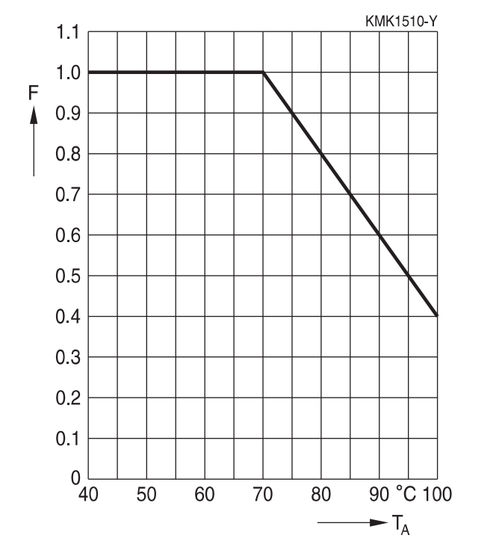
Why more capacitor current reduction is desired ?
Capacitor design is heavily compensated for higher ambient temperature driving.
Temperature inside the trunk reaches up to 15°-20° higher than the ambient temperature.
Capacitor current rating is derated at higher temperatures.
More parallel capacitors to supply same ripple current.
Defeats the purpose of compactness.
I_{rms} derating curves
"Film capacitors-Metallized polypropylene film capacitors (MKP) by EPCOS-TDK".

Slide 22
Outline
Motivation for compact traction inverter
What makes Inverter of an EV powertrain bulky ?
Influence of 800 V architecture on DC link Capacitor size and inverter efficiency
How to do capacitor sizing in 2 Level Inverter ?
Algorithm for capacitor selection
Identification of optimal switching frequency zone
Why more capacitor current reduction is desired ?
Utilization of SiC for reduction in losses and size of heat sink
High dv/dt problems due to 800 V bus and SiC
How common mode voltage is detrimental to motor health
Topological overview of Traction Inverters for passenger BEVs
Comparison of Inverter Candidates operating with SVM at Base speed Ma = 1.15
Carrier Interleaved and fundamental phase shift modulated Multi-phased 2 Level Inverters
Results of interleaving and fundamental phase shift on capacitor rms current
Trade-off between minimum capacitor current and min common mode operating angles

Slide 23
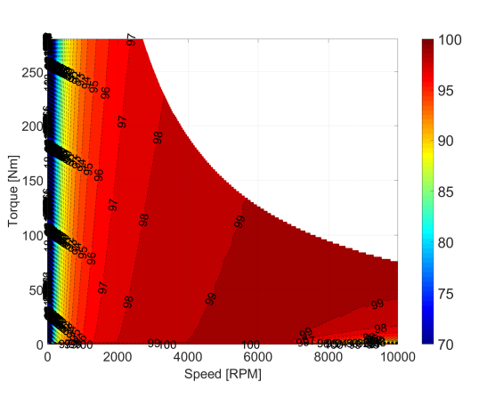
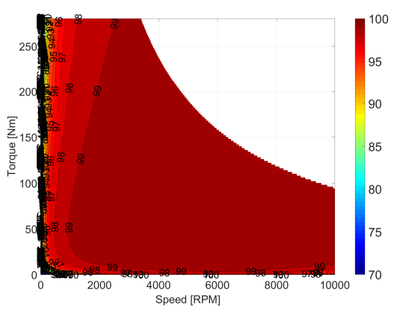
Utilization of SiC for reduction in losses and size of heat sink
1200 V Si IGBT
1200 V SiC MOSFET
H. Kim, H. Chen, J. Zhu, D. Maksimović and R. Erickson, "Impact of 1.2kV SiC-MOSFET EV traction inverter on urban driving,"
Notes:
SiC has reduced the losses in the low speed regions—defining urban driving zone.

Slide 24
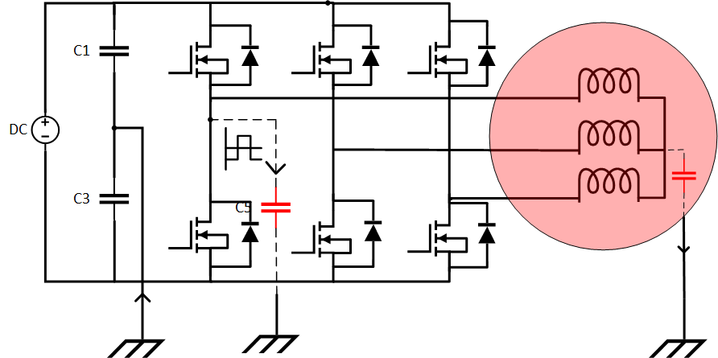
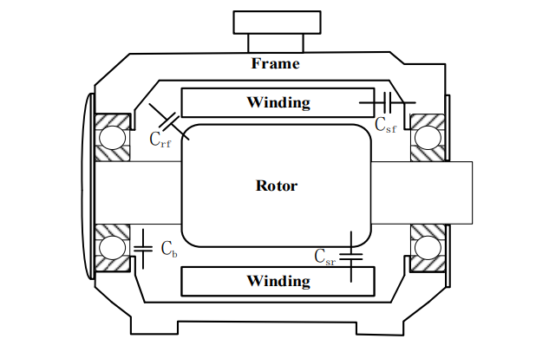
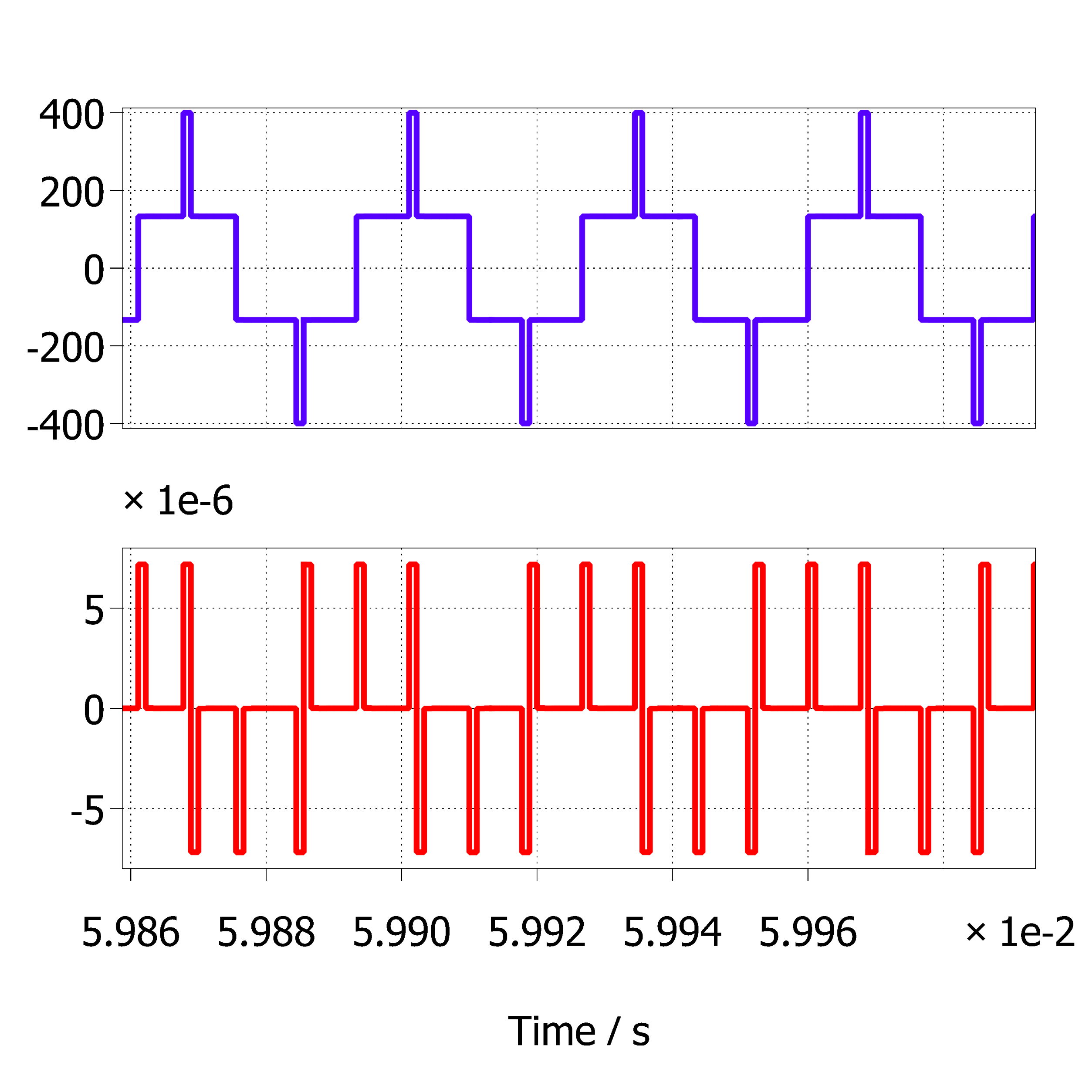
High dv/dt problems due to 800 V bus and SiC
Stator frame
I_{cm}
V_{cm}
I_{cm}

Slide 25
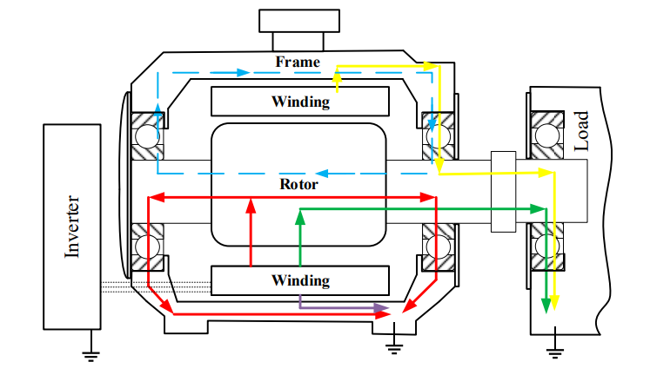
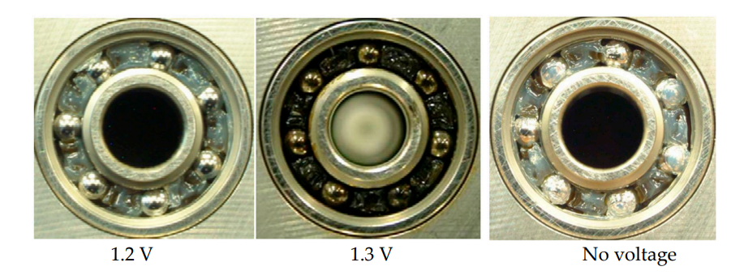
How common mode voltage is detrimental to motor health
Ma, J.; Xue, Y.; Han, Q.; Li, X.; Yu, C. Motor Bearing Damage Induced by Bearing Current: A Review. Machines 2022, 10, 1167. https://doi.org/10.3390/machines10121167

Slide 26
Outline
Motivation for compact traction inverter
What makes Inverter of an EV powertrain bulky ?
Influence of 800 V architecture on DC link Capacitor size and inverter efficiency
How to do capacitor sizing in 2 Level Inverter ?
Algorithm for capacitor selection
Identification of optimal switching frequency zone
Why more capacitor current reduction is desired ?
Utilization of SiC for reduction in losses and size of heat sink
High dv/dt problems due to 800 V bus and SiC
How common mode voltage is detrimental to motor health
Topological overview of Traction Inverters for passenger BEVs
Comparison of Inverter Candidates operating with SVM at Base speed Ma = 1.15
Carrier Interleaved and fundamental phase shift modulated Multi-phased 2 Level Inverters
Results of interleaving and fundamental phase shift on capacitor rms current
Trade-off between minimum capacitor current and min common mode operating angles

Slide 27
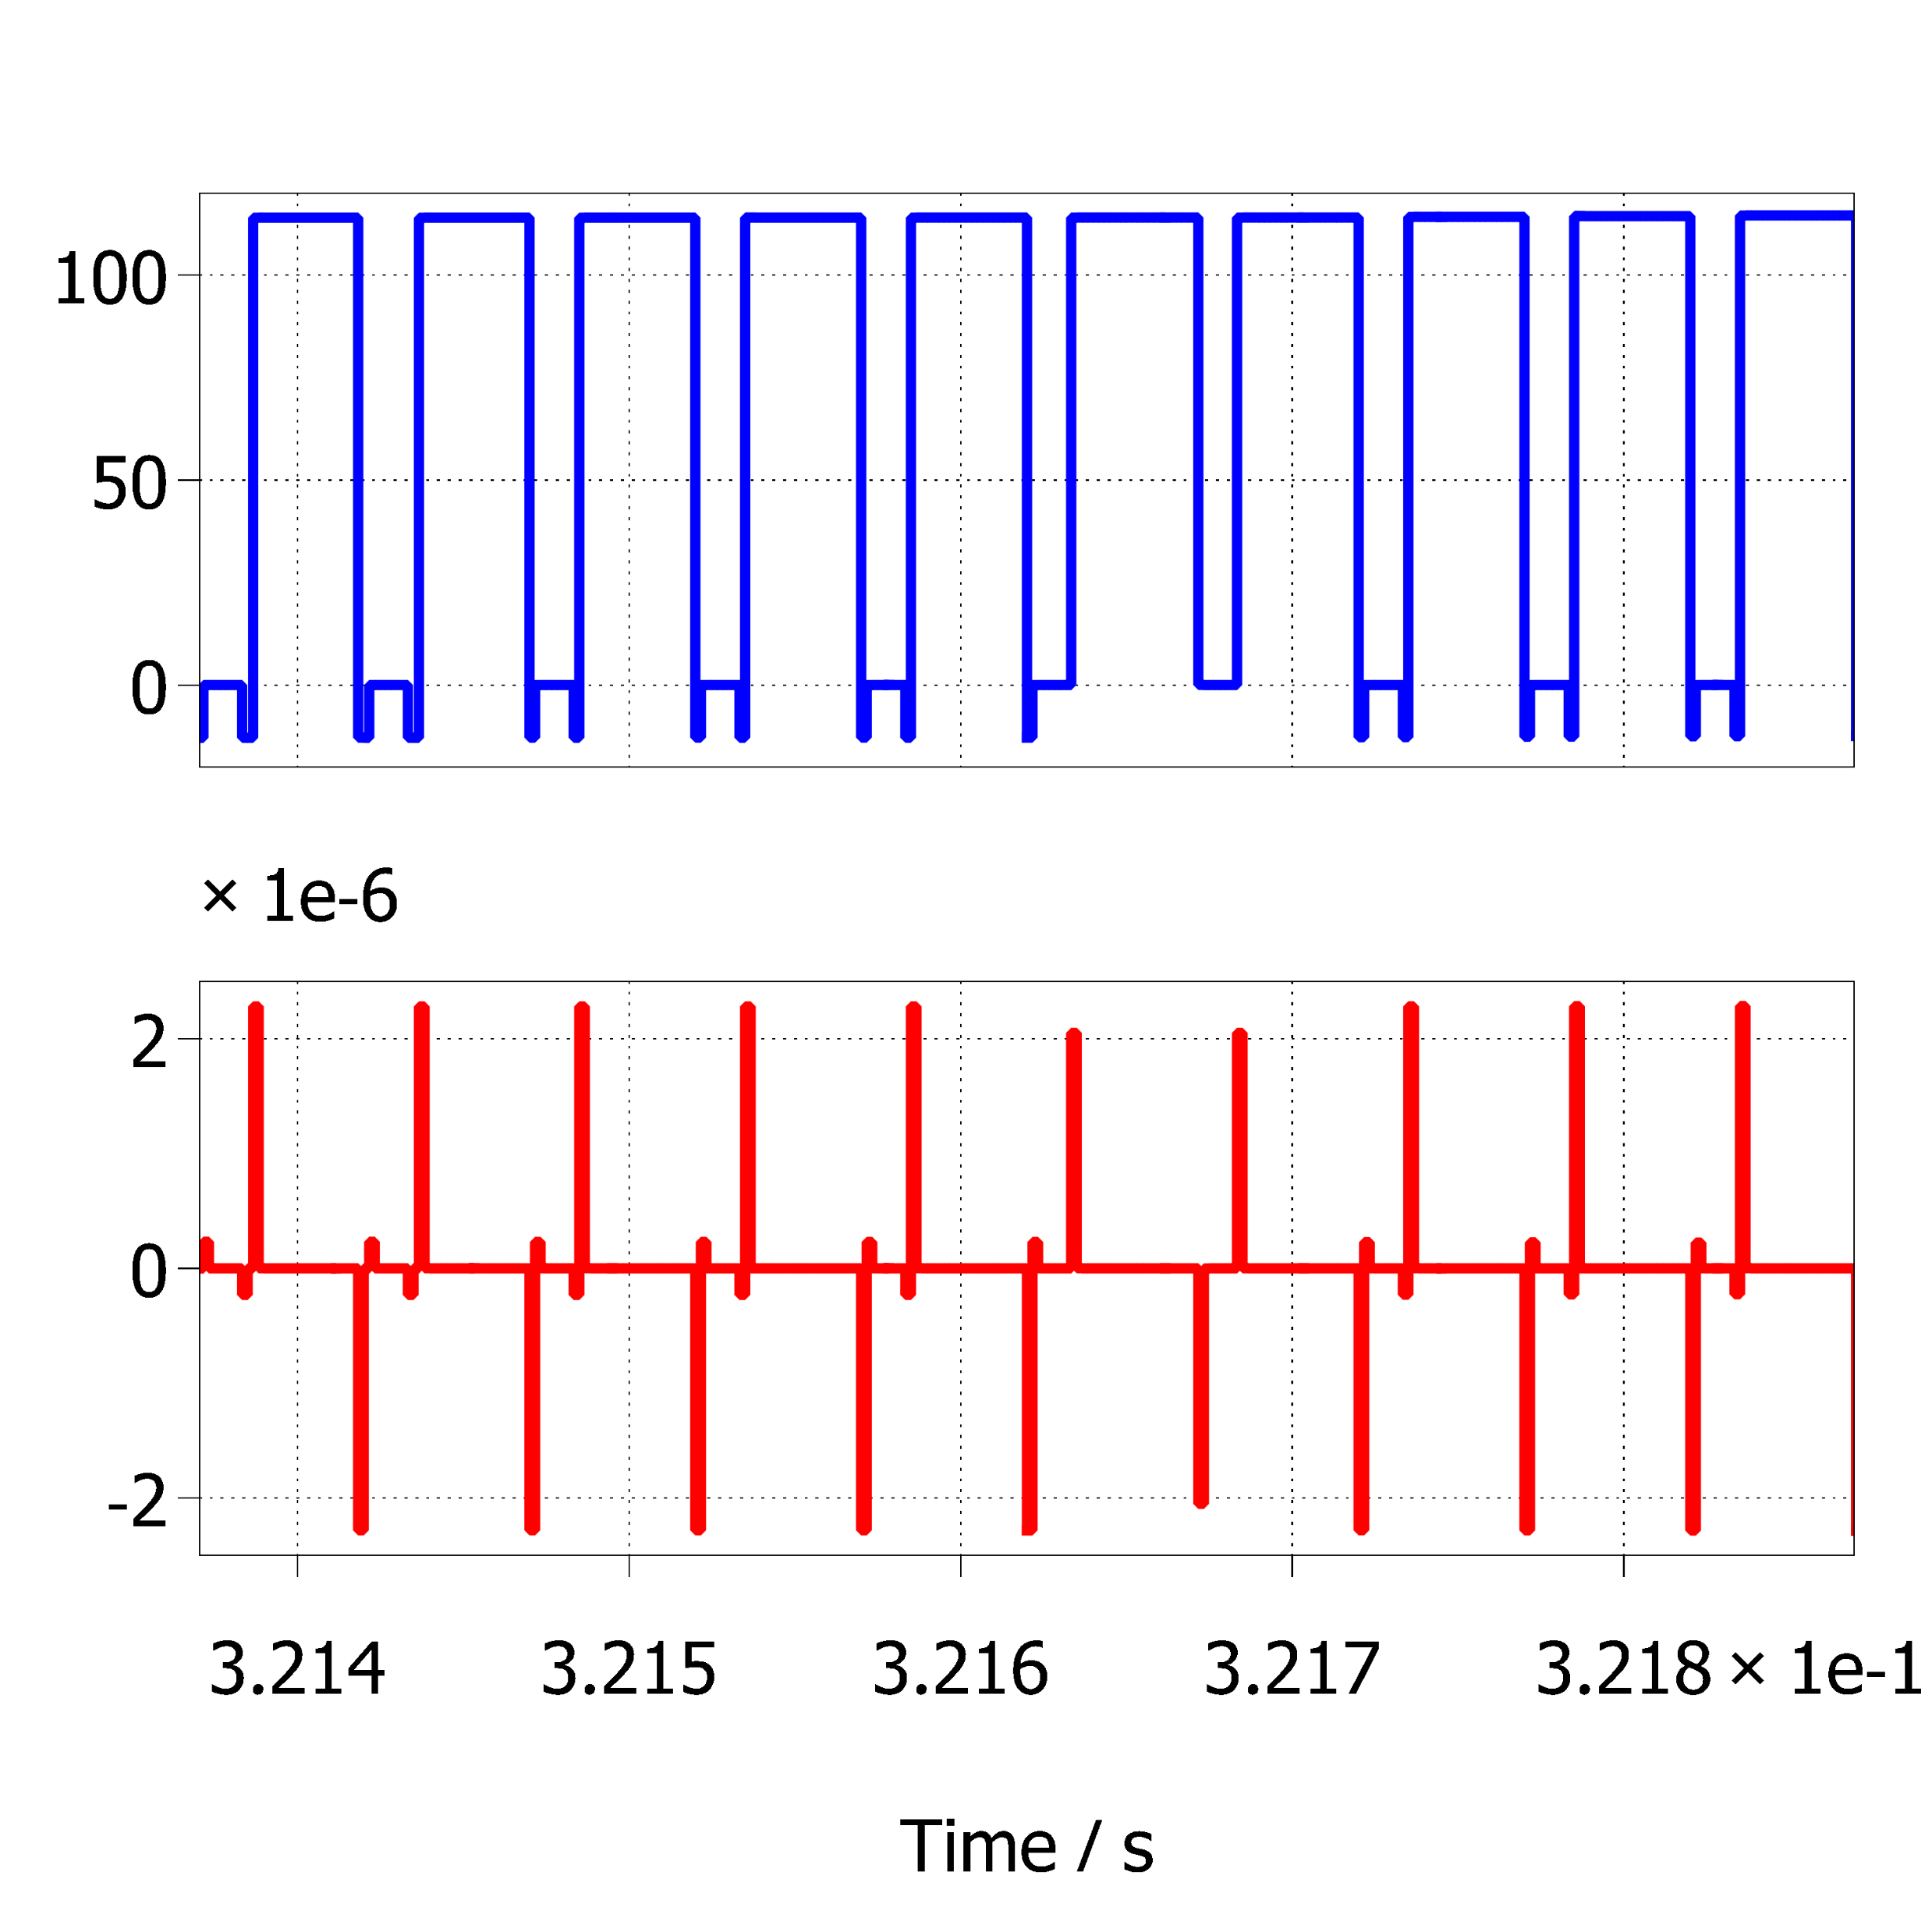
Topological overview of Traction Inverters for passenger BEVs with the…
Aim: To search for a Topology which can reduce
Capacitor ripple current
Common mode voltage
Common mode problem can be addressed using 3-Level Inverters
2 Level Single VSI
TNPC
V_{cm}
V_{cm}
I_{cm}
I_{cm}
Notes:
Till here we have seen that to solve one problem (Compactness) we have worsen another problem. So what can be done now ?
Going for higher level becomes costly from economic point of view and faces component reliability issue for the manufacturer. So automotive inverters are restricted up to 3 Level only.

Slide 28
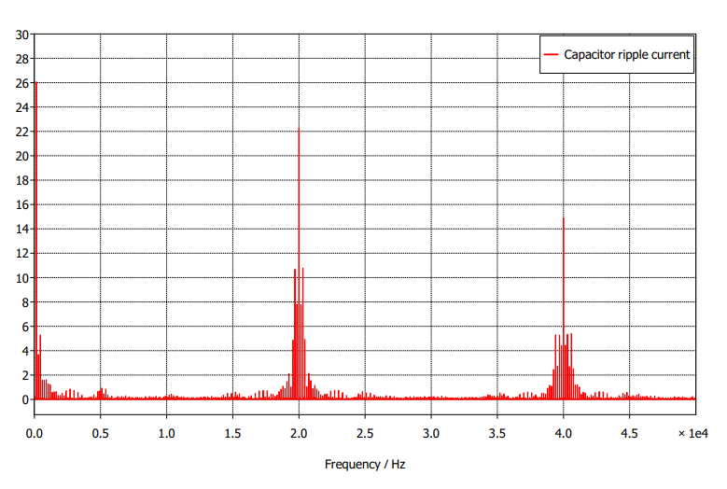
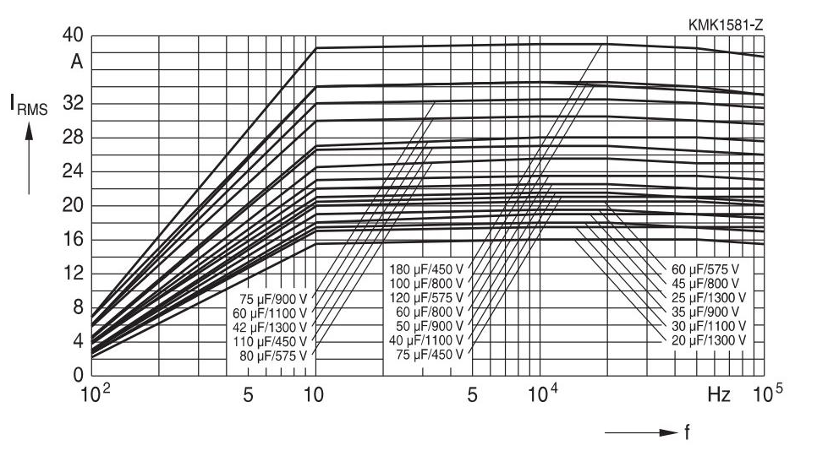
Capacitor current ripple problem still persists in 3 Level Inverters
2 Level Single VSI
TNPC
Notes:
Till here we have seen that to solve one problem (Compactness) we have worsen another problem. So what can be done now ?
Going for higher level becomes costly from economic point of view and faces component reliability issue for the manufacturer. So automotive inverters are restricted up to 3 Level only.
Due to dominant 3rd harmonic ripple current in 3 Level inverters and capacitor voltage balancing issue, 3 Level Inverters are not adopted in Passenger Evs Traction Inverters.

Slide 29
Comparison of Inverter Candidates operating with SVM at Base speed Ma = 1.15
Inverter Topology 92kW V_{dc} = 800 V | 2 Level Single (Module) | 2 Level dual Φ = 60; θ = 60 (Module) | 2 Level Dual coupled inductor inverter θ = 180°, 80° (Module) | T-NPC (Switches) | HANPC (Module) | T-NPC Segmented (Discrete Switch)
DC link capacitor current | 42 A | 24 A | 45.9 A, 27.8 A | 40 A | 40 A | 19.72 A
Efficiency | 98.84 % | 99.4 % | 99.4 % | 98.34 % | 98.94 % | 99.42 %
IGBTs(Low Freq) | 0 | 0 | 0 | 0 | 12 | 0
Total MOSFETs | 6 | 12 | 12 | 12 | 6 | 24
Diodes | 0 | 0 | 0 | 0 | 12 | 0
Switch cost | 35,691 | 47,722 | 47,722 | 34,434 | 47,427 | 68,864
Line THD | 55.36 % | 53.47 % | 37.75% ,37.67% | 33.18 % | 26.86 % | 33.43 %
CM voltage peak | 0.5 Vdc | 0.33 Vdc | 0.16 Vdc ,0.33 Vdc | 0.1775 Vdc | 0.5 Vdc | 0.1775 Vdc
Φ is fundamental phase shift angle, θ is interleaving angle
Notes:
PLECS based simulation was done for all the inverter topologies for a power level of 90 kW , losses were estimated using thermal modelling descriptions mentioned in the datasheet of selected modules and switches.

Slide 30
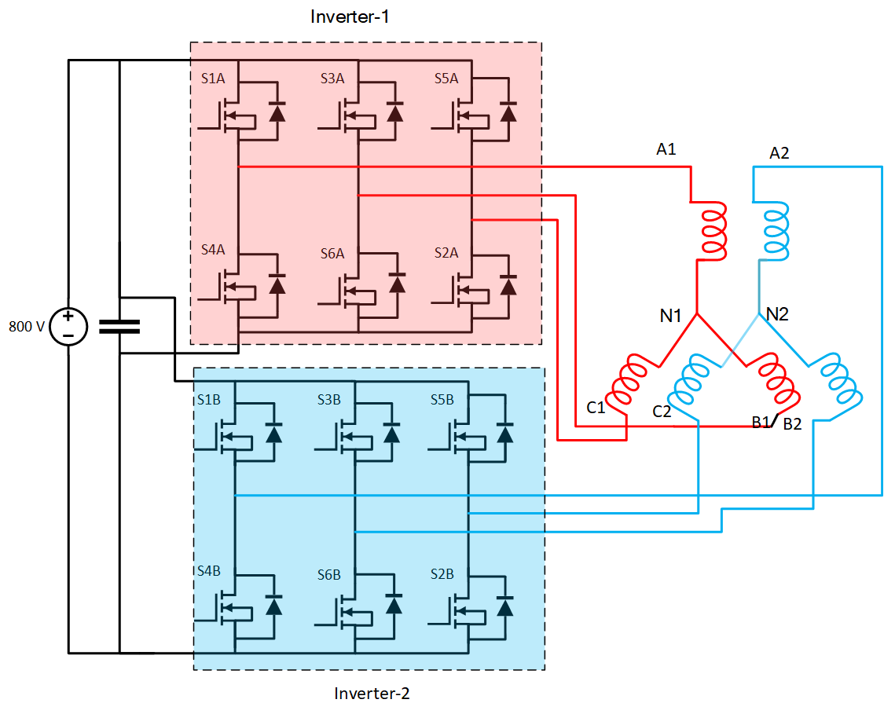
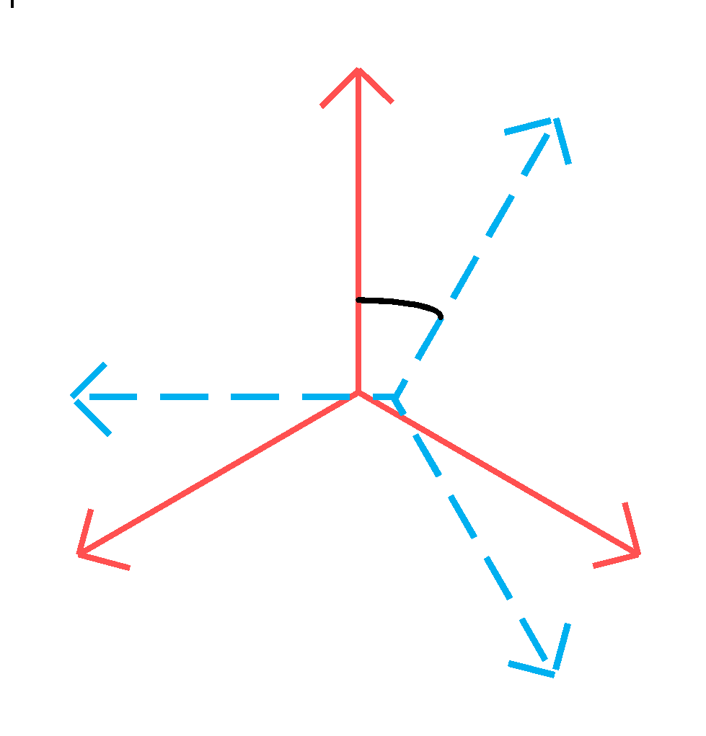
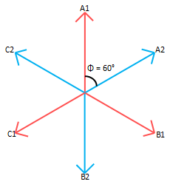
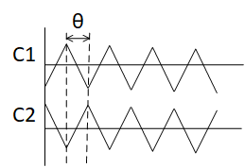
Carrier Interleaved and fundamental phase shift modulated Multi-phased 2 Level Inverters
𝛟
θ is interleaving angle
Φ is Fundamental phase shift angle
Notes:
So if three level cannot be used than what is the option ?

Slide 31
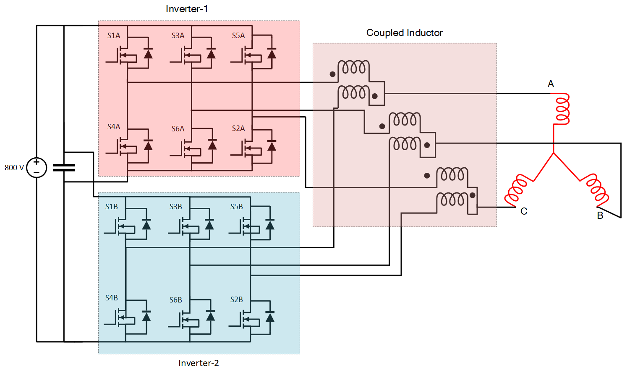
2 Level Dual Inverter Based Topologies
2-Level Dual Inverter for Multi-phase Machines
2-Level Coupled Inductor Dual Inverter for 3-phase machines
No circulating current problem
No extra magnetics is required
Carrier interleaving is possible
Fundamental current phase shift is possible
Circulating current due to direct connection of phases A1-A2 etc
Required extra coupled inductor to reduce circulating current
Fundamental current phase shift is not possible
Notes:
Since magnetic energy density is lower than capacitor energy density due to this reason reduction of cap size will be over-shadowed by the coupled inductors, hence defeating the purpose of compactness. Therefore Coupled inductor will not be considered as an option.

Slide 32
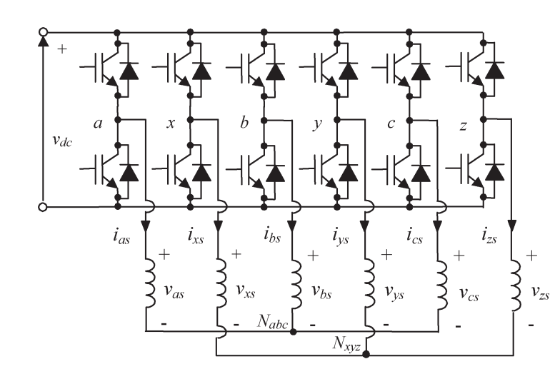
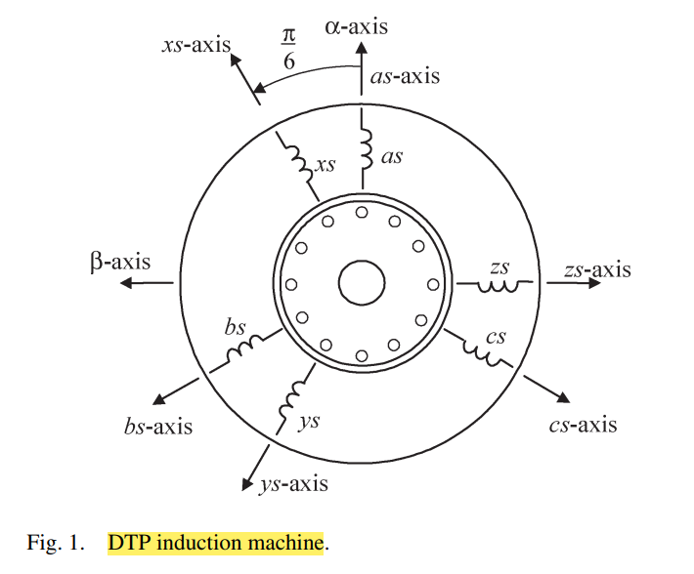
Advantages of Dual 3 phase machines
Division of power helps to select devices of lower current rating.
High reliability at system level due to abundant structure.
Lower torque pulsations at high frequency.
Reduced motor harmonic current.
High power per ampere ratio for the same machine volume.
Reduced harmonic current in the DC link capacitor in the case of VSI fed drives.
If the isolated neutrals are connected to the mid point of the dc bus , 40 % torque density is reported.
Advantages have been reported. Jitendra has written a paper on it and its in my whatsapp.

Slide 33
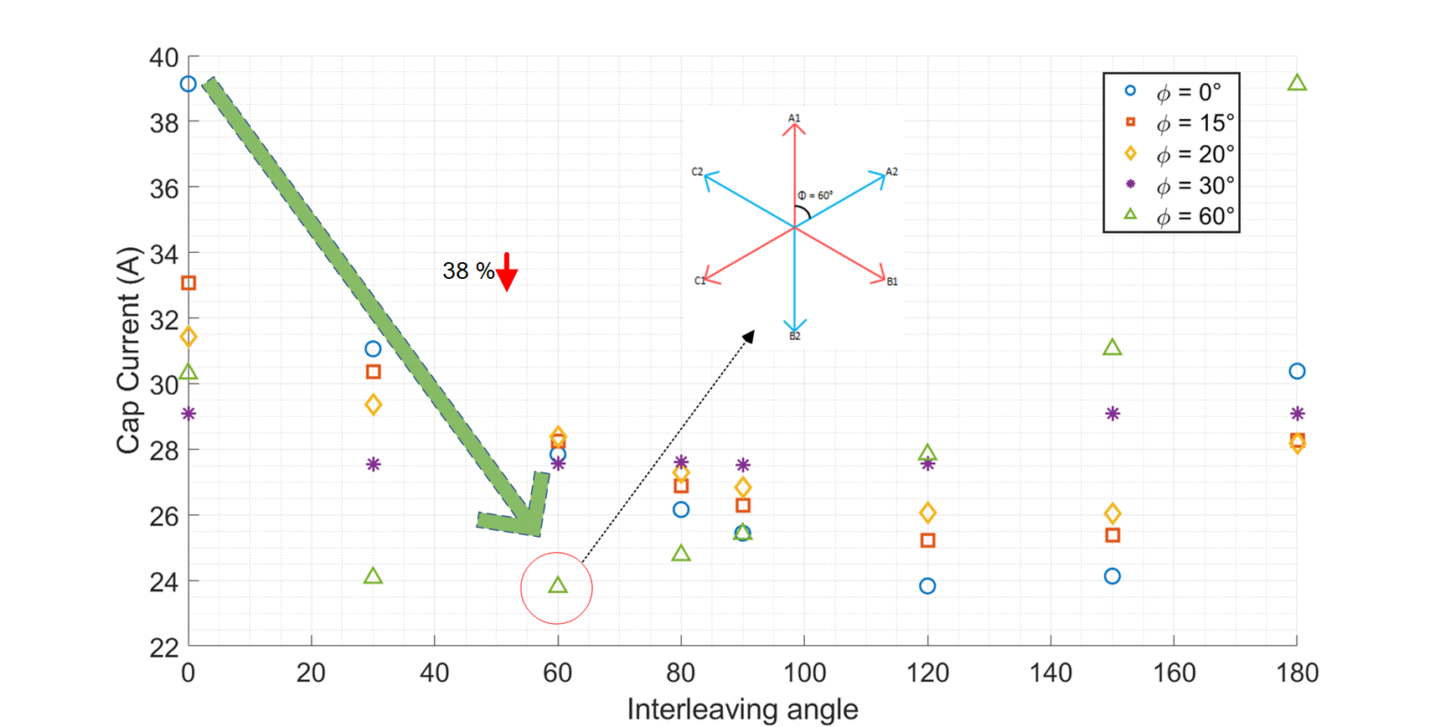
Ma = 1.15, V^{f}_{L-L} = 562 V , I_{Phase} = 52 A (Base speed modulation index)

Slide 34
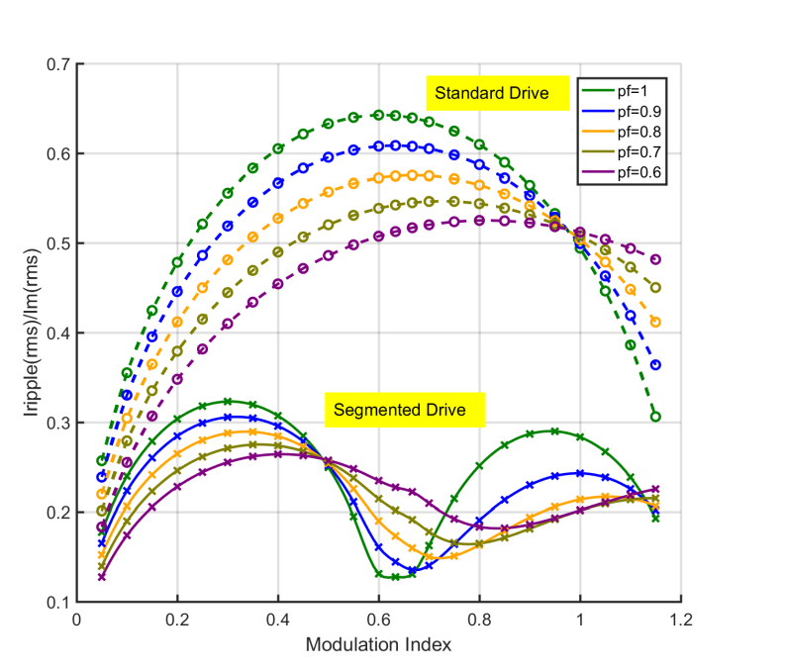
Interleaving angle at which maximum capacitor current reduction takes place, changes with Ma, pf
M and Ma are same…. Mistake is done while typing formula
G. -J. Su and L. Tang, "A segmented traction drive system with a small dc bus capacitor,"
Notes:
Three points were taken under the below base speed region to check for the fundamental phase shift angle at which capacitor ripple current is minimum. In both the cases reduction of approximately 40 % was observed at 60 degree, but interleaving angle changed.

Slide 35
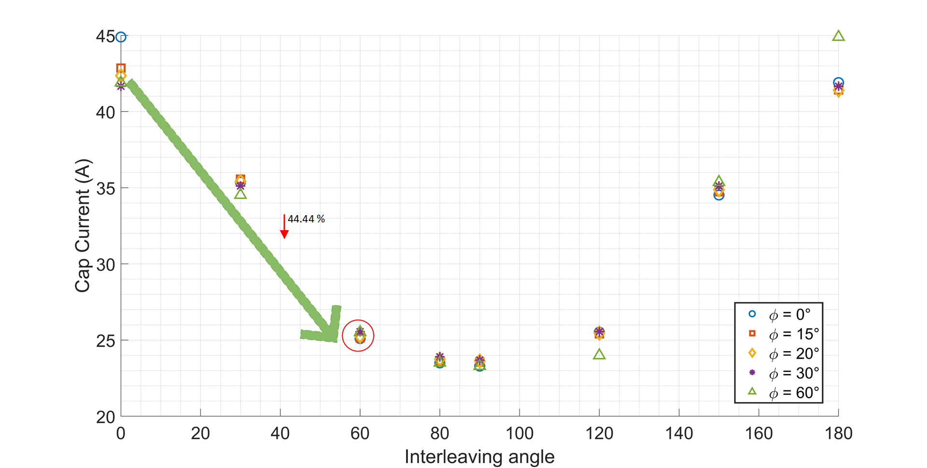
Ma = 0.85, V^{f}_{L-L} = 416.48 V, I_{phase} = 38 A

Slide 36

Ma = 0.65, V^{f}_{L-L} = 318 V , I_{Phase} = 30 A (Maximum reduction modulation index)
Notes:
But motor is designed to give rated torque at rated speed, which is observed at base modulation index of 1.15 i.e when maximum rated voltage is applied on the motor. Phi = 60 degree and theta = 60 degree is chosen as point of design for DC link capacitor.

Slide 37

Notes:
But motor is designed to give rated torque at rated speed, which is observed at base modulation index of 1.15 i.e when maximum rated voltage is applied on the motor. Phi = 60 degree and theta = 60 degree is chosen as point of design for DC link capacitor.

Slide 38

Trade-off between minimum capacitor current and minimum common mode operating angles
Common mode voltage comparison at φ = 60°
Interleaving angle = 60 °
Interleaving angle = 180 °
Capacitor ripple current is minimum at 60 °
Vcm is minimum at 180 °
Notes:
But motor is designed to give rated torque at rated speed, which is observed at base modulation index of 1.15 i.e when maximum rated voltage is applied on the motor. Phi = 60 degree and theta = 60 degree is chosen as point of design for DC link capacitor.
Clear tradeoff is observed between minimum common mode voltage angle and minimum capacitor ripple current angle.

Slide 39
Comparison of Inverter Candidates operating with SVM at Base speed Ma = 1.15
Inverter Topology 92kW,DC bus= 800 V | 2 Level Single (Module) | 2 Level dual Φ = 60; θ = 60 (Module) | 2 Level Dual coupled inductor inverter θ = 180°, 80° (Module) | T-NPC (Switches) | HANPC (Module) | T-NPC Segmented (Switches)
DC link capacitor current | 42 A | 24 A | 45.9 A, 27.8 A | 40 A | 40 A | 19.72 A
Efficiency | 98.84 % | 99.4 % | 99.4 % | 98.34 % | 98.94 % | 99.42 %
IGBTs(Low Freq) | 0 | 0 | 0 | 0 | 12 | 0
Total MOSFETs | 6 | 12 | 12 | 12 | 6 | 24
Diodes | 0 | 0 | 0 | 0 | 12 | 0
Switch cost | 35,691 | 47,722 | 47,722 | 34,434 | 47,427 | 68,864
Line THD | 55.36 % | 53.47 % | 37.75% ,37.67% | 33.18 % | 26.86 % | 33.43 %
CM voltage peak | 0.5 Vdc | 0.33 Vdc | 0.16 Vdc ,0.33 Vdc | 0.1775 Vdc | 0.5 Vdc | 0.1775 Vdc
Φ is fundamental phase shift angle, θ is interleaving angle

Slide 40




Zero CM SVM technique
D. Jiang, Z. Shen, and F. Wang, "Common-Mode Voltage Reduction for Paralleled Inverters," in IEEE Transactions on Power Electronics, vol. 33, no. 5, pp. 3961-3974, May 2018, doi: 10.1109/TPEL.2017.2712369.
Notes:
So to further red

Slide 41
Future Work
Simulation implementation of ZERO CM SVM technique for common mode reduction at selected (𝚽, θ) = (60°,60°).
Deciding of Power Level for working lab prototype.
Hardware implementation of the decided topology.
2 Level Dual Inverter

Slide 42
References
1. "Electrical and electronics technical team roadmap," U.S. DOE Vehicle Technology Office, Washington DC, USA, Tech. Rep., Oct 2017.
2. J. W. Kolar, T. M. Wolbank, and M. Schrodl, "Analytical calculation of the RMS current stress on the DC link capacitor of voltage DC link PWM converter systems," 1999. Ninth International Conference on Electrical Machines and Drives (Conf. Publ. No. 468), Canterbury, UK, 1999, pp. 81-89, doi: 10.1049/cp:19990995.
3. J. Reimers, L. Dorn-Gomba, C. Mak, and A. Emadi, "Automotive Traction Inverters: Current Status and Future Trends," in IEEE Transactions on Vehicular Technology, vol. 68, no. 4, pp. 3337-3350, April 2019, doi: 10.1109/TVT.2019.2897899.
4. A. Poorfakhraei, M. Narimani, and A. Emadi, "A Review of Multilevel Inverter Topologies in Electric Vehicles: Current Status and Future Trends," in IEEE Open Journal of Power Electronics, vol. 2, pp. 155-170, 2021, doi: 10.1109/OJPEL.2021.3063550.
5. Y. Wang, A. Poorfakhraei, N. Mehdi, and A. Emadi, "Comparative Analysis of 2-Level and 3-Level Voltage Source Inverters in Traction Applications," 2021 IEEE Transportation Electrification Conference & Expo (ITEC), Chicago, IL, USA, 2021, pp. 614-619, doi: 10.1109/ITEC51675.2021.9490160.
6. I. Aghabali, J. Bauman, P. J. Kollmeyer, Y. Wang, B. Bilgin, and A. Emadi, "800-V Electric Vehicle Powertrains: Review and Analysis of Benefits, Challenges, and Future Trends," in IEEE Transactions on Transportation Electrification, vol. 7, no. 3, pp. 927-948, Sept. 2021, doi: 10.1109/TTE.2020.3044938.
7. "Film capacitors-Metallized polypropylene film capacitors (MKP) by EPCOS-TDK."
8. https://goodcalculators.com/inside-car-temperature-calculator/.
9. G.-J. Su and L. Tang, "A segmented traction drive system with a small dc bus capacitor," 2012 IEEE Energy Conversion Congress and Exposition (ECCE), Raleigh, NC, USA, 2012, pp. 2847-2853, doi: 10.1109/ECCE.2012.6342375.
10. D. Jiang, Z. Shen, and F. Wang, "Common-Mode Voltage Reduction for Paralleled Inverters," in IEEE Transactions on Power Electronics, vol. 33, no. 5, pp. 3961-3974, May 2018, doi: 10.1109/TPEL.2017.2712369.
11. Ma, J., Xue, Y., Han, Q., Li, X., & Yu, C. (2022). Motor Bearing Damage Induced by Bearing Current: A Review. Machines, 10(12), 1167. https://doi.org/10.3390/machines10121167
12. https://afdc.energy.gov/vehicles/how-do-all-electric-cars-work
13. H. Kim, H. Chen, J. Zhu, D. Maksimović, and R. Erickson, "Impact of 1.2kV SiC-MOSFET EV traction inverter on urban driving," 2016 IEEE 4th Workshop on Wide Bandgap Power Devices and Applications (WiPDA), Fayetteville, AR, USA, 2016, pp. 78-83, doi: 10.1109/WiPDA.2016.7799913.

Slide 43



Comparison of two inverters having DC link of 400 and 800 V respectively driving a Motor of same power rating.
T800V = 0.5T400V
State Torque half speed double advantage
Minimum capacitance required to supply ripple current is given by;
Capacitor cost and size depends on capacitor stored energy
Since the phase current has halfed, find out the Icap ripple current as per kohlers analytical formula, as per the formula it will also be halved but verify this with simulation for same power levels.

Slide 44


Slide 45


SiC modules over discrete switches at high current and high frequency application
Switch loop inductance responsible for voltage overshoot on the device undergoing turn off.
Switch loop inductance increase when two physical device are paralleled due to the track length on PCB.
Inconsistency of device parameters, like R_{dson} can lead to current imbalance during steady state and switching transients.
H. Lee, V. Smet and R. Tummala, "A Review of SiC Power Module Packaging Technologies: Challenges, Advances, and Emerging Issues," in IEEE Journal of Emerging and Selected Topics in Power Electronics, vol. 8, no. 1, pp. 239-255, March 2020, doi: 10.1109/JESTPE.2019.2951801.

Slide 46
Problems due to paralleling of devices for achieving high power inverter
High current and/or high voltage are necessary to achieve high power. Power devices in parallel can extend current capability, but imbalance current between paralleled devices restricts the number of devices in parallel. As a result, achievable power rating is still limited. Moreover, consistent characteristics of power devices and gate drivers are required to minimize imbalance issues. Therefore, paralleling devices has challenges in mass production due to piece to piece part variation of power devices, and gate drive circuits introduced different gate control propagation delays.

Slide 47
Story stiching
Pillar 1: Arouse interest by asking engaging question.
Ask questions in the beginning ?
Benefits of reducing size of an inverter in an EV?
Need of compactness ?? Show a photo of inverter size sitting inside an EV and give some numbers as to how much space is available for fitting powertrain inside a car and how much space is occupied by the inverter.
Show a photo of an existing 400 V architecture with its size/volume mentioned alongside. Show a teardown image which shows different components sitting inside an inverter along with the volume occupied.
Pillar 2: Comprehension
3. After seeing the photos one much ask the question ? How to reduce the size of an inverter?
Size of capacitor
Size of thermals---By making efficient Inverter
Number of discrete MOSFETs/ Half-Bridge modules
Reduction in weight of cables– Opting for 800 V architecture
The solution to above points is opting for 800 V architecture, show how it can help increase efficiency, reduce size of thermal solution etc.
5. Explain why we will go for SiC modules and why not discrete switches, advantages of using a module and SiC over Si.
Also Why not use IGBT based Inverter.

Slide 48

Discussions with sir on saturday
For 3 phase segmented inverter driving a dual 3 phase load , phase shift (phi) of 30 degree along with carrier shift of 80 gives maximum icap rms reduction of 38 % in comparison to non-segmented 3 phase VSI (2 Level VSI). Which is reported in the paper and also verified by the simulation.
Sir said that he is not sure on the performance of motor, if we keep phase shift between the two windings and he will ask his friend and discuss.
Search for common mode current discussion in 6 phase machine paper/ multiphase machines paper. pending
Search for 6 phase machine in zero CM paper. Pending
Find out the effect of this minimum phase shift on common mode voltage profile in segmented inverter ? Does it change from the minimum CM voltage angle of 180 degree as reported in zero CM paper ? See the table
Segmented inverter cannot be operated in 3 level configuration but coupled inductor can operate in 3 level configuration

Slide 49
Advantages of Dual 3 phase machines
Division of power helps to select devices of lower current rating.
High reliability at system level due to abundant structure.
Lower torque pulsations at high frequency.
Reduced motor harmonic current.
High power per ampere ratio for the same machine volume.
Reduced harmonic current in the DC link capacitor in the case of VSI fed drives.
If the isolated neutrals are connected to the mid point of the dc bus , 40 % torque density is reported.
Advantages have been reported. Jitendra has written a paper on it and its in my whatsapp.

Slide 50
For dual inverter with coupled inductor at carrier shift equal to 180 degree , phase voltage becomes 3 level.
(Check for advantages of 3 Level) and there is no reduction in capacitor ripple as compared to non-segmented inverter rather it increases. Check with the coupled inductor paper and see the table shown in next slide.
At the carrier shift of 80 degree capacitor current is reduced my 33.33 % as compared to non-segmented inverter.
Maximum reported reductions are given on operating conditions where the difference in maximum. For ex. Observe the two marked points and find percentage reduction.
Maximum cap rms reduction is dependent on power factor and modulation index.
Verify the cap current reduction from this graph at 1.15 modulation index and power factor of 0.7. The reduction is 33 %. Which is what I observed through simulation.
But while selecting actual capacitor we have to select while considering the minimum capacitance reduction from this graph because PF and ma will change throughout the drive cycle ??

Slide 51
Inverter topologies and technologies reported in the literature.
2 Level Inverter
Multi-phased 2 Level Inverter
3 Level Inverter
Multi-phased 3 Level Inverter (T-type or others) (More number of switches so can be sidelined)
Explain with the single diagram what is the meaning of Multiphase. Use Generic diagram without any topology.
Advantage of 3 Level V/s 2 Level, Find out from papers. Specifically common mode reduction.
Compare all of them on the grounds of;
Capacitor Size, Efficiency(Because it would lead to compact thermal design), Loss/ switch (related with better reliability), one more thing see from notes/ask sir, line voltage THD, higher THD means higher harmonic current in stator winding means higher motor cu losses.
Explain by example how to select a capacitor based on a lifetime approach (Epcos)
2 level Topology:- Single inverter, Multi-phased inverter driving 6 phase Load--Requires open winding machine, Multi-phase inverter driving single phase load requires coupled inductors.
3-Level Topologies
Here is my doubt…how to build a story for proving why I thought 3 level inverters as good candidates?
ANPC---- why I choose them as inverter candidates
TNPC--- Reported for Low-Medium voltage EVs
HANPC---Explain why it makes a good candidate ? How to think about this ? Ask sir
Establish with the help of an example that reduction in size is proportional to reduction in current

Slide 52
7. Conclude why 2 Level with interleaving is the best option if it is? and why not any 3 Level based on comparisons done previously. (State problems with the 3 level inverter, cap voltage balancing, large size of cap size due to dominant low frequency component)… Put simulation results and know the theoretical inside out.
8. Express a problem that by going with 2 Level along with SiC switches has imposed a large common mode voltage variation on the inverter, little of which can be overcome by using interleaving. (This was done on coupled inductor inverter) . This can be explained with the help of plots drawn.
9. Now is the good time in the slide to explain what common mode voltage is and how it is detrimental for motor health.(Motor bearing paper is the reference)
10. Compare the common mode voltage variations for
Single 2 level Inverter
Multi-phased Dual inverter with varying angles of interleaving and point out the angle with lowest common mode voltage.
Show that still some common mode voltage is left and we want to eliminate it as well.
Explain Zero CM SVM and how it can achieve zero CM. (Pending)
Show the implementation of this scheme and its effect on ZERO CM in 6 phase inverter, paper are there in common mode folder.
In dual 3 phase 30 degree is helpful?

Slide 53
Check by sinpwm what is the reduction in DC cap current in dual inverter with coupled inductor at an interleaving angle of 180 degree?
Plot of interleaving angle v/s capacitor current in coupled inductor inverter at spwm and svm.
Look results from the deeper insight and understand why is it happening.
Assymetrical machine phases are made in multiple of 3. (6,9,12 etc)---Jitendra slide
Phi for that machine is 180/n . i.e [30,20,15] degree. Phi is the electrical angle of current flowing in each set of three phase winding.
Show mathematical relation shown by sir that to get same amount of torque as from a three winding machine we have to keep the spatial displacement angle of winding equal to the electrical angle of the currents.
Now based on this justification whether we can have either a 3 phase 6 winding machine, 3 phase 9 winding machine or a 3 phase 12 winding machine.
So iterate through different value of inter leaving angle while taking one phi[15,20,30] at a time in dual three phase machine. But for a dual three phase machine we cant inject current at any other angle than 30 to get same torque than why should we vary the phi for 3 phase dual winding ? machine.??

Slide 54

6 phase displaced by and varied angle theta
6 Phase star connected machine
Give advantage of 6 phase machines.
No circulating current in the motor windings, which was in coupled inductor approach.
Z. Shen, D. Jiang, T. Zou and R. Qu, "Dual-Segment Three-Phase PMSM With Dual Inverters for Leakage Current and Common-Mode EMI Reduction," in IEEE Transactions on Power Electronics, vol. 34, no. 6, pp. 5606-5619, June 2019, doi: 10.1109/TPEL.2018.2866338.
L. Chen and B. Ge, "High Power Traction Inverter Design and Comparison for Electric Vehicles," 2018 IEEE Transportation Electrification Conference and Expo (ITEC), Long Beach, CA, USA, 2018, pp. 583-588, doi: 10.1109/ITEC.2018.8450259.

Slide 55


Vcm at minimum capacitance interleaving angle
Observe tradeoff here

Slide 56

M = 1.15, V^{f}_{L-L} = 562 V, I_{phase} = 52 A

Slide 57
2 Level Dual Segmented Inverter for six phase machine
Common mode voltage affect can be seen between the negative bus of two inverters. See simulation.
It also has the common mode problem and its techniques are available in the literature
Z. Shen, D. Jiang, Z. Liu, D. Ye and J. Li, "Common-Mode Voltage Elimination for Dual Two-Level Inverter-Fed Asymmetrical Six-Phase PMSM," in IEEE Transactions on Power Electronics, vol. 35, no. 4, pp. 3828-3840, April 2020, doi: 10.1109/TPEL.2019.2933446.

Slide 58

Common Mode Path Modelling for a Dual Three phase machine
Ma, J.; Xue, Y.; Han, Q.; Li, X.; Yu, C. Motor Bearing Damage Induced by Bearing Current: A Review. Machines 2022, 10, 1167. https://doi.org/10.3390/machines10121167
A. M. Alcaide et al., "Common-Mode Voltage Mitigation of Dual Three-Phase Voltage Source Inverters in a Motor Drive Application," in IEEE Access, vol. 9, pp. 67477-67487, 2021, doi: 10.1109/ACCESS.2021.3072967.

Slide 59
Vcm at minimum capacitance interleaving angle
φ = 60°
Interleaving angle = 60 °
Interleaving angle = 180 °
Capacitor ripple current is minimum at 60 °
Vcm is minimum at 180 °

Slide 60
Ma = 1.15, V^{f}_{L-L} = 562 V , I_{Phase} = 52 A (Base speed modulation index)

Slide 61
Interleaving angle at which maximum capacitor current reduction takes place, changes with M

Slide 62
Ma = 0.65, V^{f}_{L-L} = 318 V , I_{Phase} = 30 A (Maximum reduction modulation index)

Slide 63
Coupled Inductor inverter for 3 phase machines
This inverter increases the size of system due to coupled magnetics.
Due to advantages of 6 phase machine over 3 phase machine, I am ruling out this topology. Because to make the drive compact we have to move towards a 6 phase machine…search for advantage.
D. Jiang, Z. Shen and F. Wang, "Common-Mode Voltage Reduction for Paralleled Inverters," in IEEE Transactions on Power Electronics, vol. 33, no. 5, pp. 3961-3974, May 2018, doi: 10.1109/TPEL.2017.2712369.

Slide 64


Slide 65
Conclusions from the table
In segmented 2 Level inverter driving dual 3 phase machine, dc link capacitor value is minimum at fundamental phase shift angle of 60 degree and carrier shift angle of 60 degree, but common mode voltage is not completely zero which can be reduced using zero cm modulation.
2 Level coupled inductor inverter reduces the common mode voltage swing to 0.16 Vdc from 0.5 Vdc at carrier interleaving angle of 180 degrees but increases the dc link capacitor current so this cannot be considered.
The same inverter topology reduces the dc link capacitor current by 33.8 % when interleaving angle is 80 degree. But it also increase the common mode voltage to 0.33 Vdc. Which can be tried to reduced using zero CM modulation.
TNPC segmented inverter offers dc link capacitor current reduction of 50 % at any interleaving angle and common mode voltage swing of 0.1775 Vdc. Further modified modulation scheme like zero CM can be looked for reducing CM voltage swing.
MTP-2
Application of zero CM technique in 2 Level to reduce the CM voltage, check whether zero CM modulation can make vcm zero for both the interleaving angles mentioned in the table.(180,80).
Take help from sir regarding the svpwm implementation of 6 phase star connected converter. Quoted paper below the particular slide of 6 phase star connected inverter says that it can be done using svpwm. Some one may catch me if they see different value of current in cap current trend graphs.

